Slide 1
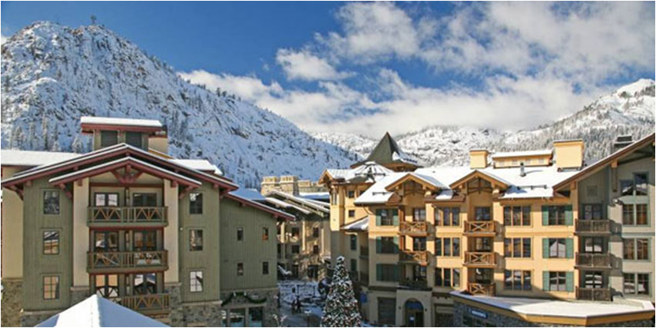
22 Station Owners’
Annual Meeting
22 Station Owners Association Board of Directors
October 10, 2026

Slide 2
Agenda
9:00am – 10:15am
Open Meeting
Annual Presentation
  Overview
  22 Station Financials
    Assessments
    Operating Financial Planning
    Reserve Funds
Consideration of IRS Revenue Rule 70-604
Open Forum
Election

Slide 3
Introductions
22 Station Owners Association
Physical and Legal Real Estate
  151 Residential Units, 55 Commercial Units, Upper and Lower Parking Units (P1 /P2)
  Common Area – Exterior Roofs, Walls between Units, Ceilings, and Floors, Hallways, Spa, Elevators, Lobbies, HVAC, Boilers, and Other PP&E and Structural Components
151+ Residential Homeowners, Owner(s) of Commercial Units (PTR with 14 tenants), Owner of Upper Parking Units (PVNC and P1), and Owner of Lower Parking Units (PTR and P2)
22 Station HOA Board of Directors -- Two (2) Residential Directors and One (1) Commercial Director
  Arthur Chiang, President, Homeowner
  Jon Grant, Treasurer, Homeowner
  Mike DeGroff, Palisades Tahoe Resort Services

Slide 4
Palisades Tahoe Hospitality (PTH) Provides Property Management to Support 22 Station
Property Management for 22 Station: Common Area and HOA Administration – Stacia Lange and PTH Teams
22 Station Roles and Responsibilities
Manage and Maintain Common Area Infrastructure
Procure Infrastructure Services
Prudent Financial Management
Conform to the Civil Code and CC&R’s
Property Management Agreement (PMA)
Monitor and Maintain/Clean Infrastructure and Common Area
Manage A/R and A/P and Finance Support
Administrative Support
Field Owner Requests and Complaints
www.22station.com/propertymanager

Slide 5
Palisades Tahoe Operates For Profit Hospitality Businesses (PTH) on 22 Station Property Independent of the HOA
Rental Management for Individual Owners Independent of 22 Station
  Rental Agent and Property Management of Individual Homeowner Units
  Maintenance, Housekeeping, and Front Desk Services for these Homeowners
  Individual Homeowners have a rental and individual unit property management agreement with Palisades Tahoe Hospitality
Independent Services Provided for a Fee by Palisades Tahoe Hospitality for Individual Homeowners and their Units with Mutual Consent
  Telephone/WIFi (WiFi is now complimentary)
  Maintenance/Housecleaning of Individual Residential Units
  Parking in P2

Slide 6
Springboard Hospitality Provides Asset Management and Advisory Support
Introduction: https://www.springboardhospitality.com/
  Property Manager for 300+ properties
  215 properties are with Major Brands -- Top Performing Management Company/Marriott, Americas Hotel of the Year Award/IHG, Award of Excellence/Hilton
  Industry Leading Properties – Reader Choice Award/Conde Nast, Michelin Key Winner, World’s Best Award/Travel & Leisure, Americas Best Award/Outside Magazine
  Operate Condo/Hotel HOA Properties Nationwide including Hawaii.
Role and Responsibilities
  Advise 22 Station Board on management of the property
  Actively monitor and provide recommendations
  Perform periodic physical inspections no less than each quarter
  Advise on insurance claims affecting the property

Slide 7
22 STATION Financial Update
GOAL = Annual Break-even budgeting, prudent fiscal management and application of Reserve Funds
  FY 2025-26 Budget and Actuals and FY 2026-27 Budget
  Assessments Match Projected/Actual Expenses
  Reserve Fund
  Prior Period Financial Statements

Slide 8
Operating Results FY 2025-2026
Actual Revenues were $3,029,746 for year end 6/30/2026
(FY2025-2026 budget = $2,973,476)
Actual Expenses were $2,993,285 for year end 6/30/20256 (FY2025-2026 budget = $3,293,631)
Actual Surplus for year end 6/30/2026 was $36,461
Utility expenses comprised 39% of total actual expenses in FY2025-2026
FY2026-2027 Budget anticipates increases in electricity rates, water and sewage, some maintenance items, and general inflation

Slide 9
IRS Revenue Rule 70-604
Prudent Financial Management during the Fiscal Year
  Revenues Match Expenses to break-even
  Minimizing Expenses including Taxes
“Resolved that 22 Station make an IRS revenue ruling 70-604 election which allows excess assessments, over and above the amounts used for the operation of the property, to be returned to the owners or applied to the following year's assessments”

Slide 10
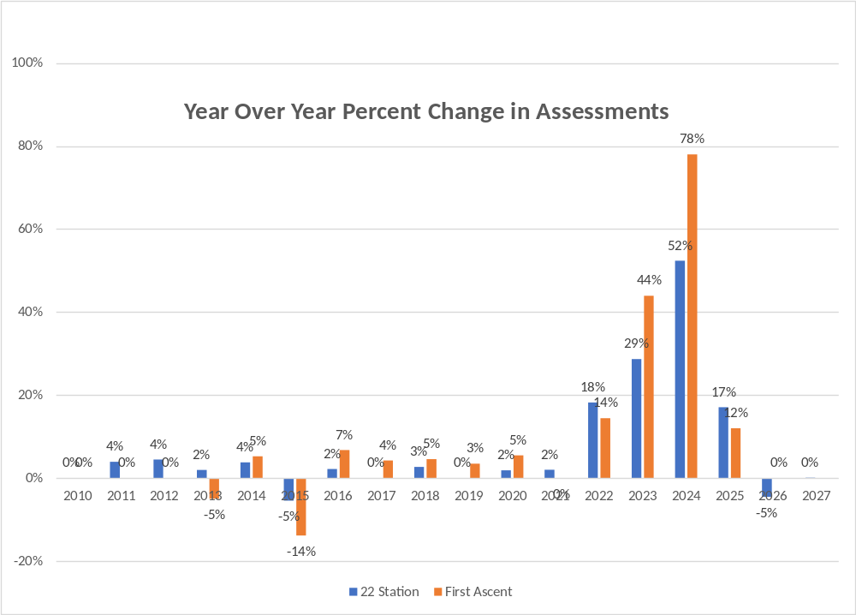
Assessments
Primary and Nearly Sole Source of Operating and Reserves Funding for 22 Station
Payable and due quarterly: Jul 31, Oct 31, Jan 31 & Apr 30
Notes:
10

Slide 11
Budget: Operating Fund
2026/2027 Uses
Admin
Insurance
Electricity
Utilities = 45%
Gas
Management
Sewer &Water
Maintenance
Cable TV

Slide 12
Major Expense -- Insurance
*Estimated
$483
$202*
FY2026-27
PTH and Mamich
Springboard/Hotel Equities and Marsh McClennan
For FY 2026-2027, P&C Policy with Springboard/Hotel Equities and Marsh McClennan Agency
  Full Value Coverage; $215,000 annual premium ($0.8 million in prior year with different broker and carrier)
  In prior years, 22 Station relied on PTH as the property manager and Mamich as the broker
  For Fiscal Year 2026-27, 22 Station relies on SB/HE as the asset manager, Marsh McClennan as the broker, and PTH as the property manager

Slide 13
Potential Prospective Insurance Advantage

Slide 14
Major Expense -- Electricity
*Estimate
Liberty Electric has filed for an additional 13% rate increase

Slide 15
Major Expense -- Propane
Historically, Propane Gas Vendors added a margin of $0.30 - $0.50.
Recent Negotiations and Change of Suppliers Lowering Effective Margins from about $0.36 to $0.10 for a Net Benefit of $0.26 or roughly 15% decrease in the per gallon price of propane.

Slide 16
Major Expense – Maintenance
Non-Discretionary Operating Expenses
  Snow removal
  Proactive mission critical maintenance – e.g., Elevators
  Recurring, minor repairs -- e.g., cleaning
  Unanticipated minor/major repairs
Prospective Major Reserve Expenses
  Hallway Improvements
  Building 4 and 5 roof repair/ replacement

Slide 17
Major Expense – Property Management
RFP Process with four (4) property management companies in 2024
Revised PMA with Palisades Tahoe: www.22station.com/disclosures-pma
Information about Property Manager Roles, Responsibilities, and Team: www.22station.com/propertymanager
Ongoing effort to assess other alternatives and lower PM expense

Slide 18
REVENUE aND Expense Reduction Benefits realized and Potential
Source | Description | Benefits Realized | Potential Benefits
Alternative Primary Rental and Property Management | Investigating Capabilities and Offerings of Alternative Companies | $300,000 (net $150,000) for Annual Property Insurance | For Owners in Primary Rental Program Larger Share of Revenue than 50%-60& Lower Net Expense for Property Management
Parking | Daily Fee for 3rd Party Visitors who stay overnight at the Village PTH Acts As Agent Collects Revenue for First Ascent, 22 Station, and PVNC | ∼$350,000 to $400,000 annually to PVNC in previous two years | Additional $50,000-$100,000 annually
WiFi and Telecom | Reduce Residential Owner Payments to PTH for WiFi and Telecom | $140,000 annually and collectively. ($42/month per Owner for WiFi) | $65,000 annually and collectively. ($35/month per Owner for Telecom)

Slide 19
Assessments Also FUND
RESERVEs
Reserves used to fund major capital expenditures only
Per CA state law, these funds cannot be used for operating expenses
Monies invested in money market funds, U.S. Treasuries, interest bearing bank accounts, and Certificates of Deposit – no principal at risk
Current balance of $3.6 million (as of 6/30/26)

Slide 20
UISE OF Reserve Funds
Major capital items: Roofing repairs, spa repairs, hot water system, snow melt, HVAC, structural repairs. Annual inspection of reserve study items.
Annual review of reserve study items, replacement schedule, and funding
FY 2025-2026 major projects completed:
  Boilers Replacement
  Gutters
FY 2026-2027 and future years, Potential PP&E Repairs and Capital Improvements:
  Spa Repairs
  Hallways
  Roof(s)

Slide 21
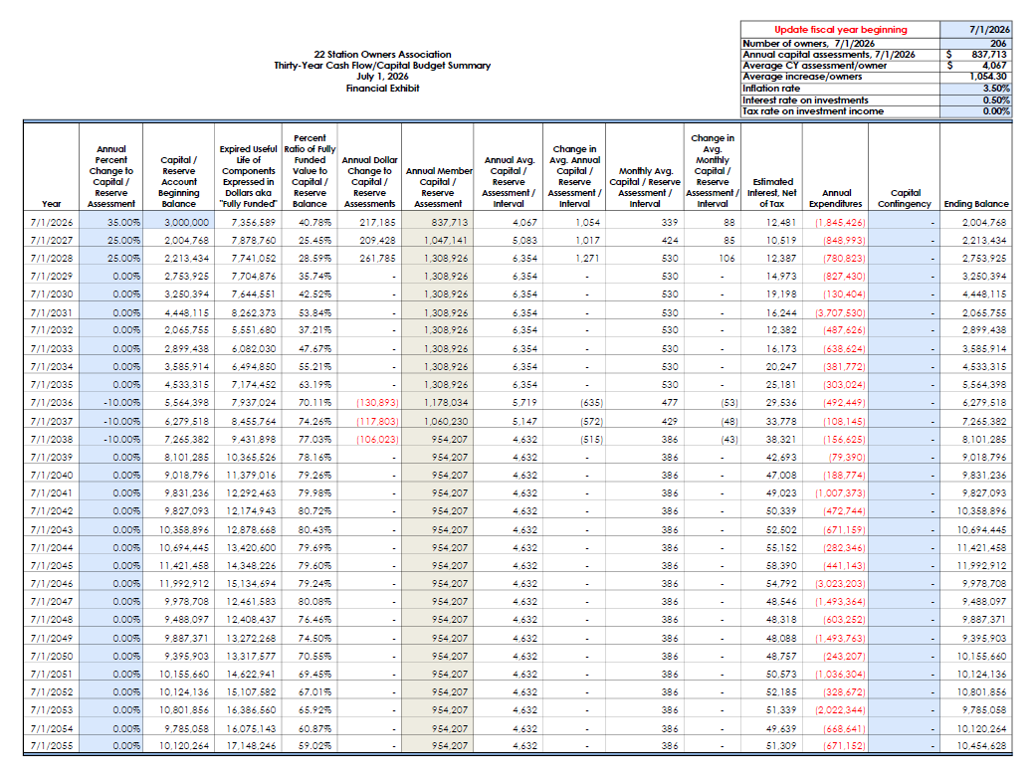
Reserve STUDY

Slide 22
FINANCIAL STATEMENTS
Available at www.22station.com/financials
2025- 2026 Year End Income Statement
2025- 2026 Year End Balance Sheet
2025- 2026 Performance Against Budget

Slide 23
Contact Information
Board Members:
  Arthur Chiang: almchia@gmail.com
  Jon Grant: jon@jongrant.in
  Commercial Director (pending election outcome)
Property Manager:
  Stacia Lange: stacialange@palisadestahoe.com

