Slide 1
Air Conditioning and 22 Station

Slide 2
This document is meant to be reviewed with the accompanying oral commentary. Without the accompanying oral commentary, readers may not obtain a complete understanding of material in this document.

Slide 3
Agenda
Introductions
Air Conditioning In Units
Q&A

Slide 4
Current AC Situation at 22 Station
The buildings do not have Central AC or any infrastructure for Central AC. Some of the Units are very warm in the spring, summer and early fall. With the possible trends in climate, possibly even warmer in the future.
Hotel guests often register negative comments in social media about the lack of effective AC.
Arguably, the portable AC units don’t support the brand of the property and may not be as effective as desired.
The future properties next door or across the street will likely have Central AC
Each Unit has electrical capacity limitations
Each building has electrical stacks that have electrical capacity limitations
Some Owners desire an AC solution that the Board will approve

Slide 5
22 Station Engaged ACCO Engineered Systems to Investigate and Design AC Solutions
Functional
Fit Within Electrical Constraints of the Building Infrastructure
  Individual Units
  Electrical Stacks of the Buildings
Aesthetic
Quiet

Slide 6
ACCO Designed Solutions For Different Configurations
Unit Type | Product | Product Description | Base* Installed Price – 1 Room with AC | Base* Installed Price – 2 Rooms with AC | Base* Installed Price – 3 Rooms with AC | Base* Installed Price – 1 Room with AC
One Bedroom | Samsung 1.5 Ton Mini split with air handler(s) and (1) condenser | https://samsung-files.s3.us-east-1.amazonaws.com/Tech_Files/Marketing_Dept/Literature/88459_Samsung_2025_FJM_Brochure_CMYK_Interactive.pdf See below also | $44,780 | $47,550 | N/A | N/A
Two Bedrooms | Samsung 2.0 Ton Mini split with air handler(s) and (1) condenser | Same as above https://www.samsunghvac.com/residential/windfree-standard | $45,700 | $47,250 | $50,000 | N/A
Three Bedrooms | Samsung 3.0 Ton Mini split with air handler(s) and (1) condenser | Same as above | $52,700 | $55,500 | $57,250 | $59,800
*Costs for permits and unforeseen expenses are in addition

Slide 7
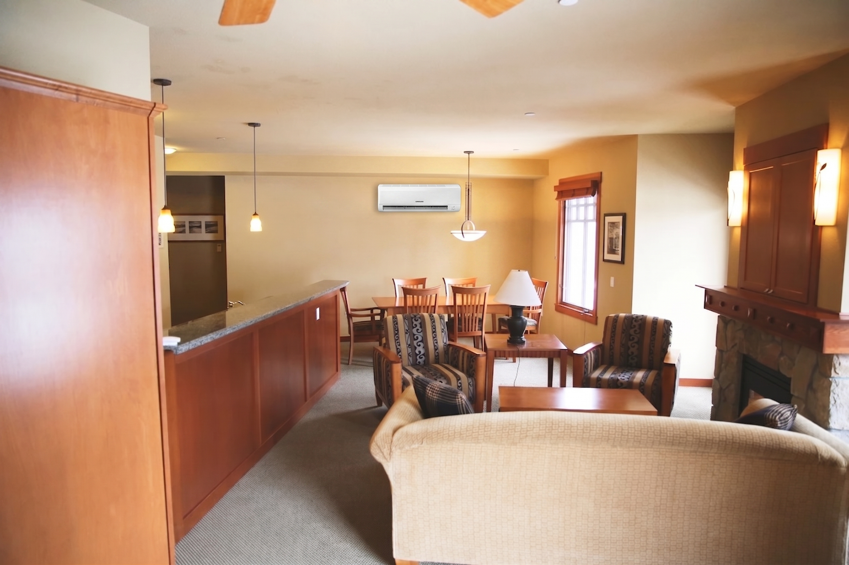
Conceptual View – One Bedroom Unit, Living Room
Air Handler
Soffit
Condensate Removal

Slide 8
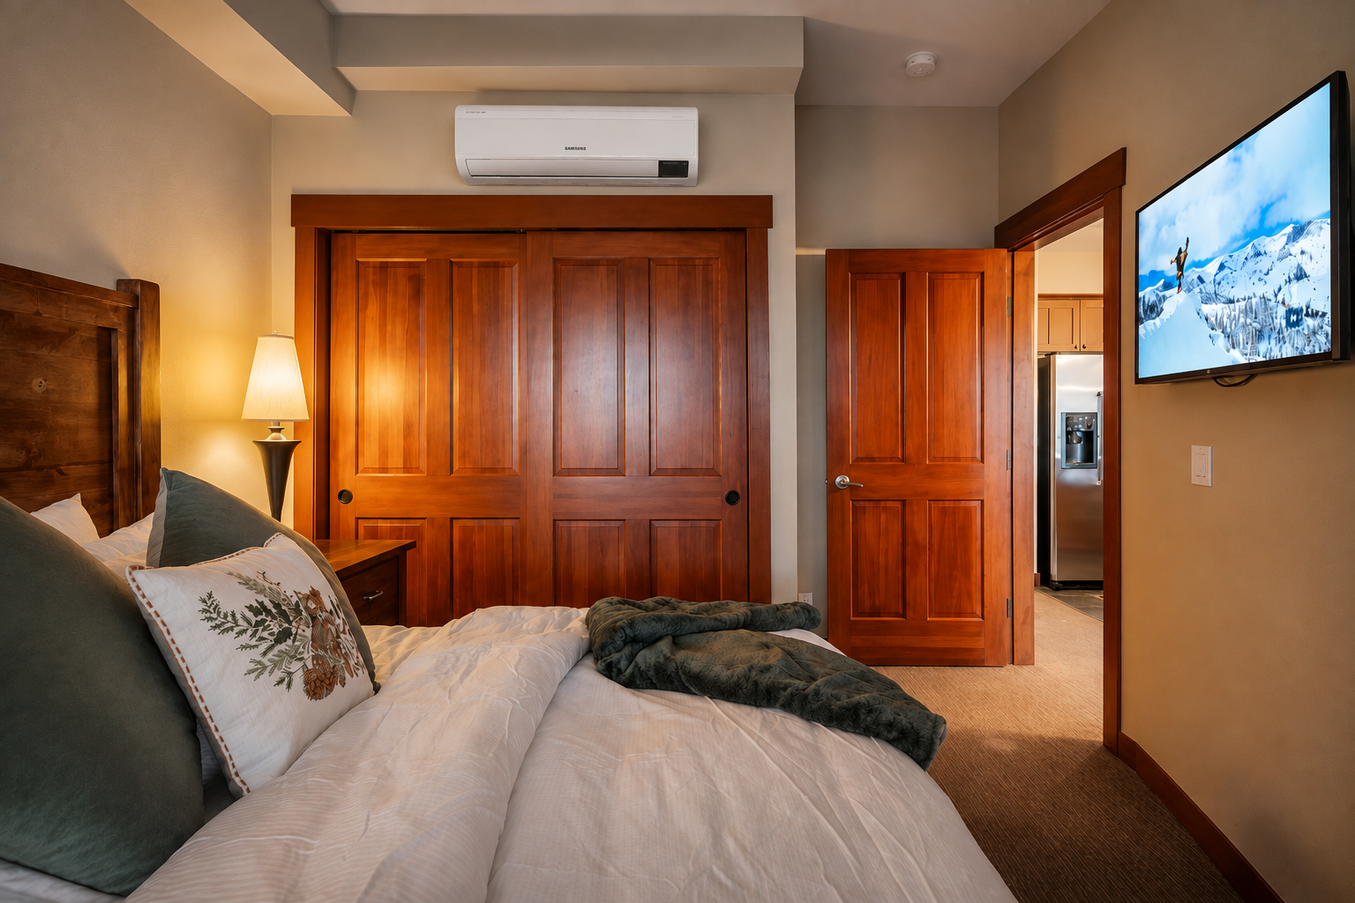
Conceptual View – One Bedroom Unit, Bedroom
Air Handler
Soffit
Condensate Removal

Slide 9
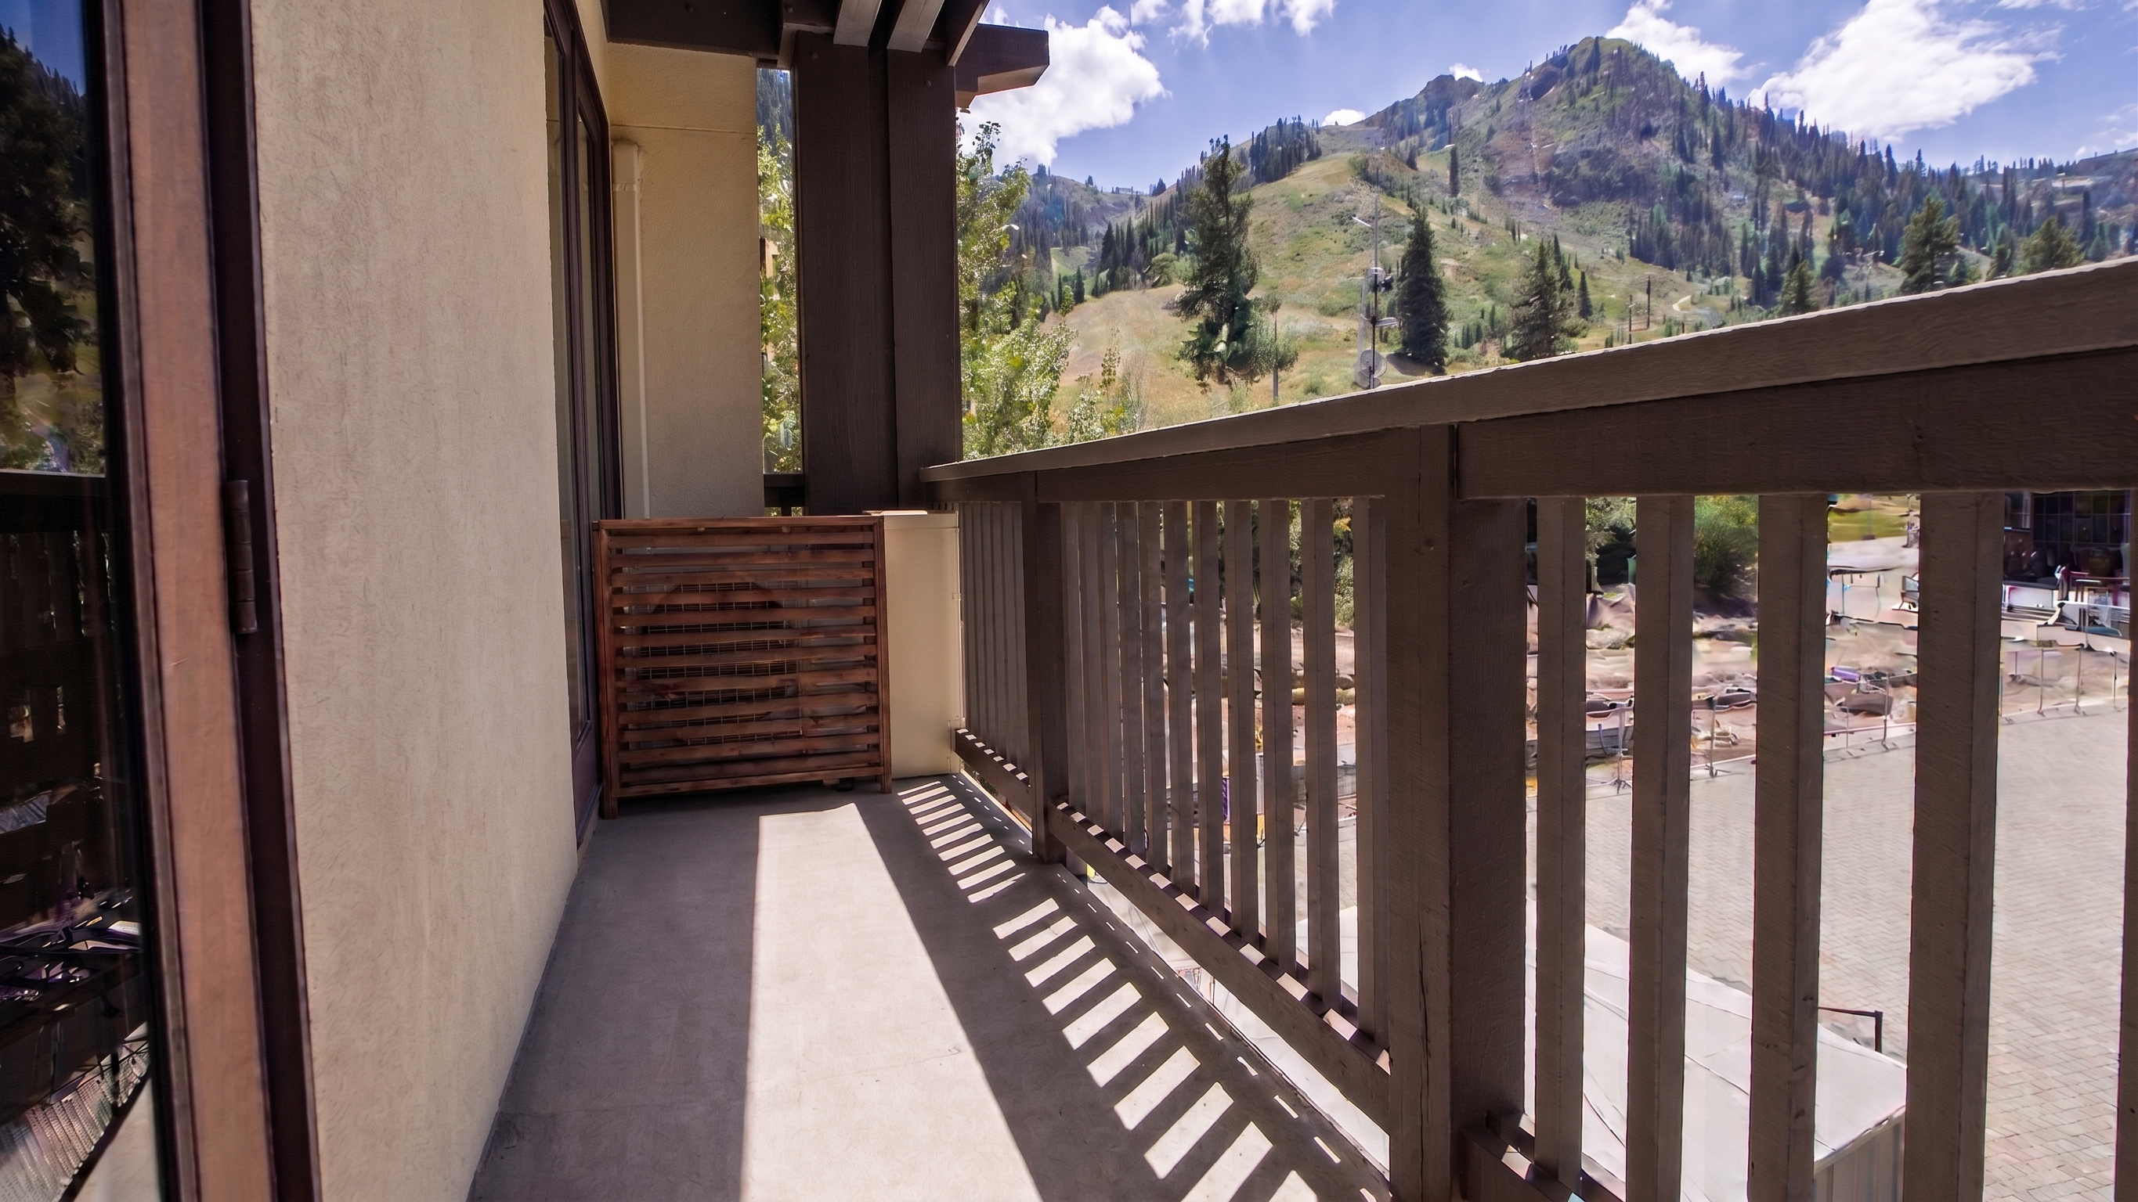
Conceptual View – Exterior Deck
Actual Location Would NOT Block Doorway

Slide 10
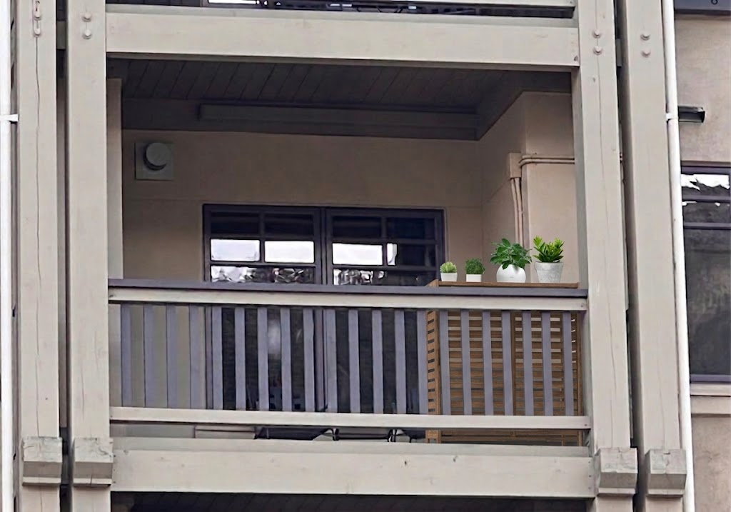
Conceptual View – Exterior Deck from Street View May Require PVNC Approval

Slide 11
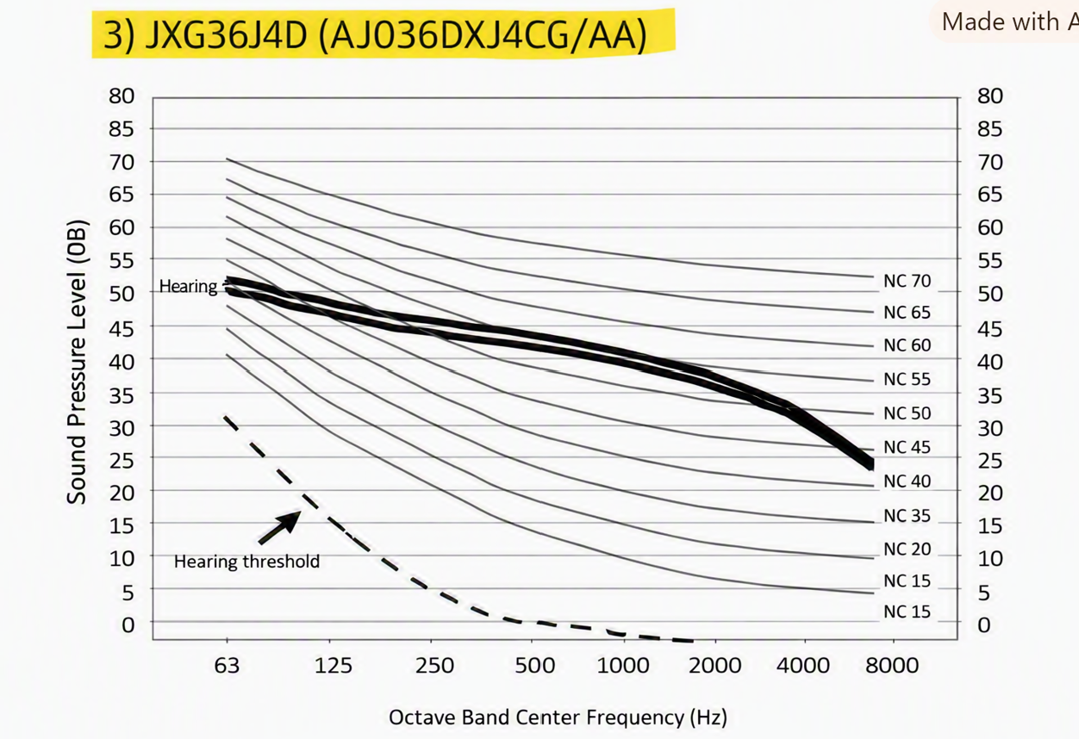
External Acoustics
50-55 dBA is manufacturer’s estimate
Roughly similar to a quiet dishwasher or modern refrigerator hum
dBA decreases 6 dba for every doubling of distance
Indoors, through modern windows, 50-55 dba typically drops to 30 –40 dBA which is similar to a laptop fan.

Slide 12
Fall 2026 Purchase and Installation
Limited Availability – three (3) to six (6) Residential Units only
15% Discount on Equipment
Indicate interest in Fall 2026 and in the future on survey at www.22station.com/actownhall

Slide 13
Q&A
The installation price seems to be way higher than expected for such equipment. Any breakdown to understand the cost?
What will be the noise level from other units? Will there be AC in the living room and kitchen?
Are the proposed systems dual-function (cooling AND heating)? If they provide heat, will owners be permitted to remove existing electric baseboard heaters to free up electrical panel capacity and reclaim wall space?
How will this effect our electricity bill paid by all homeowners. How will these individual units affect our current heating and cooling systems?
Will there be a bigger discount if more unit owners commit to moving forward?
How will this effect our electricity bill paid by all homeowners. How will these individual units affect our current heating and cooling systems?
Do we have a second contractor quotation?

